Slide 1
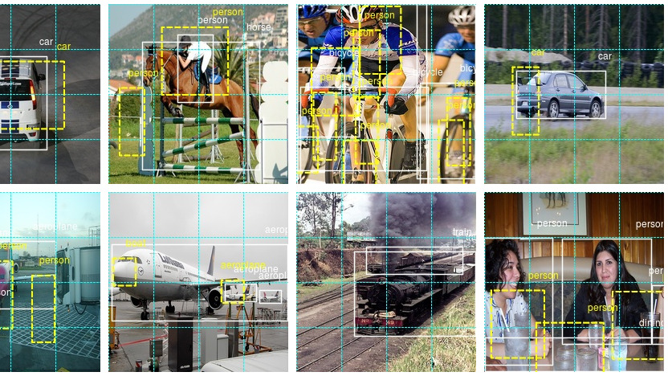


Real-Time ORB Object Detection
Submitted by:
Jasneet Arora
2210990451
Group-10
Submitted to:
Dr. Shagun Sharma
Mr. Tushar Khitoliya

Slide 2


Table of Contents
Problem Statement
Introduction
Objectives
Technical Details
Key Features
Dashboard Snapshots
References

Slide 3
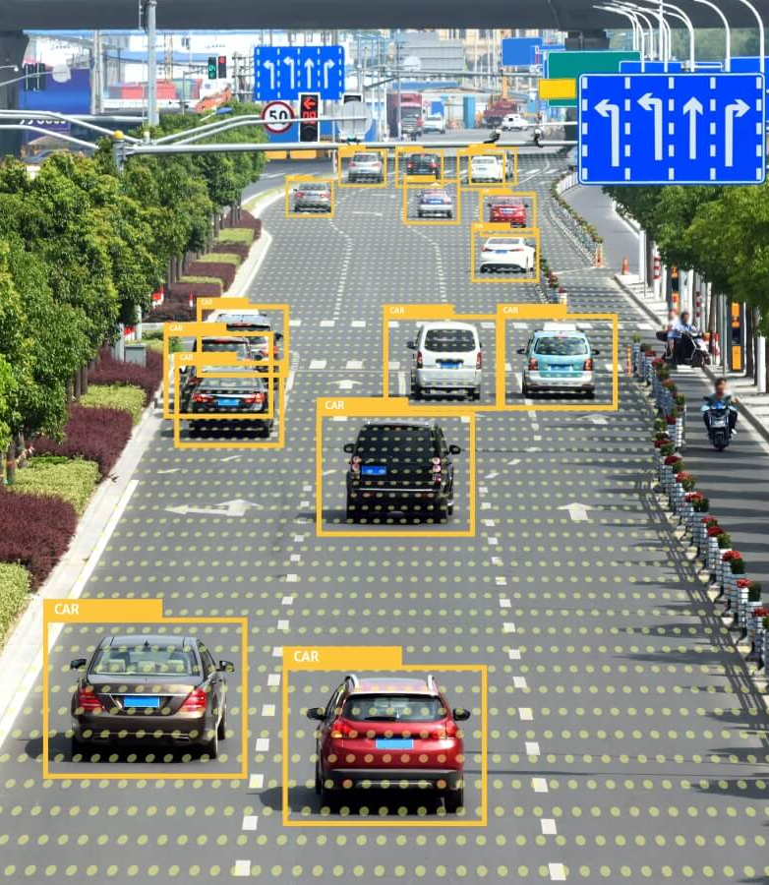
Problem Statement
Critical Object Detection
Object detection and recognition is a critical task in many computer vision applications like surveillance, autonomous vehicles, industrial inspection etc.
Training Limitations
Traditional object detection methods often rely on complex training pipelines, large labeled datasets and can be computationally expensive.
Scalability Issues
As the number of objects to detect increases, the computational requirements grow exponentially for traditional methods.
Environmental Adaptability
Traditional models struggle with varying lighting conditions, occlusions, and object orientations in real-world scenarios.

Slide 4

Introduction
Real-time object detection:
The project provides a real-time object detection system that can identify and classify a limited set of objects from a live video feed using feature detection and matching techniques.
Algorithm Selection:
The system uses the ORB (Oriented FAST and Rotated BRIEF) algorithm to extract distinctive features from objects and match them against a specified database.

Slide 5
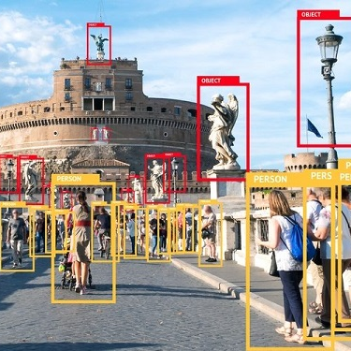
Objectives
System Development: Create a real-time object detection system using feature detection and matching for live video.
Algorithm Selection: Use the ORB (Oriented FAST and Rotated BRIEF) algorithm for efficient feature extraction and matching.
Real-Time Performance: Achieve quick and accurate object detection without extensive training data.

Slide 6

Technical Details
Key Libraries Used:
OpenCV: Utilized for computer vision tasks such as image processing and feature detection.
NumPy: Used for efficient array operations, essential for processing image data.
os: Employed for interacting with the operating system, facilitating file operations and management.

Slide 7
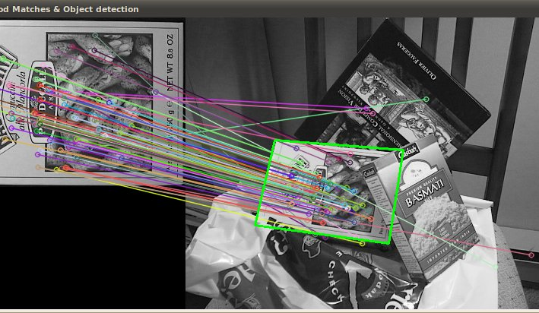
Key Features
Feature Detection: Utilizes ORB feature detection to identify key points and descriptors, capturing unique image characteristics.
Image Import: Imports images from a specified directory, extracting class names from file names to identify objects.
Descriptor Matching: Matches input image descriptors to find the most similar image by comparing them with dataset descriptors.
Real-time Image Classification: Captures webcam video, converts frames to grayscale, and continuously classifies images based on descriptors, displaying results with corresponding class names.

Slide 8




Glimpses Of The Project

Slide 9


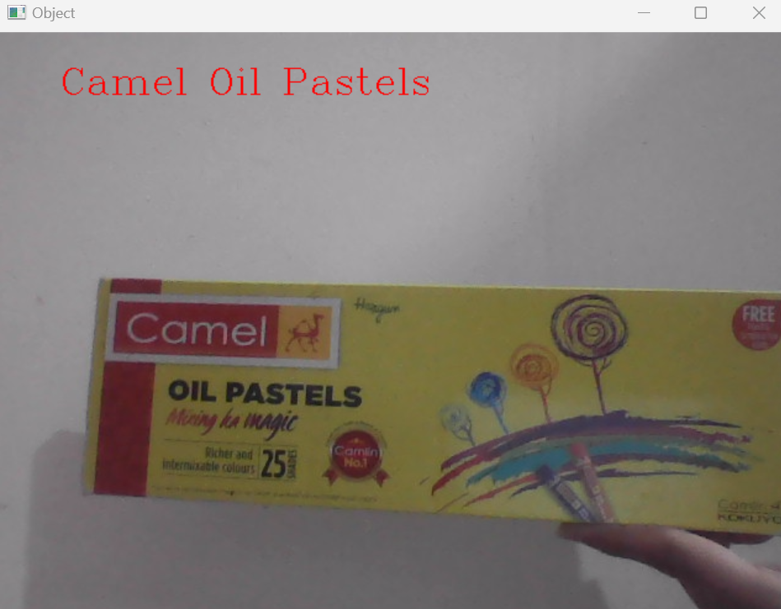
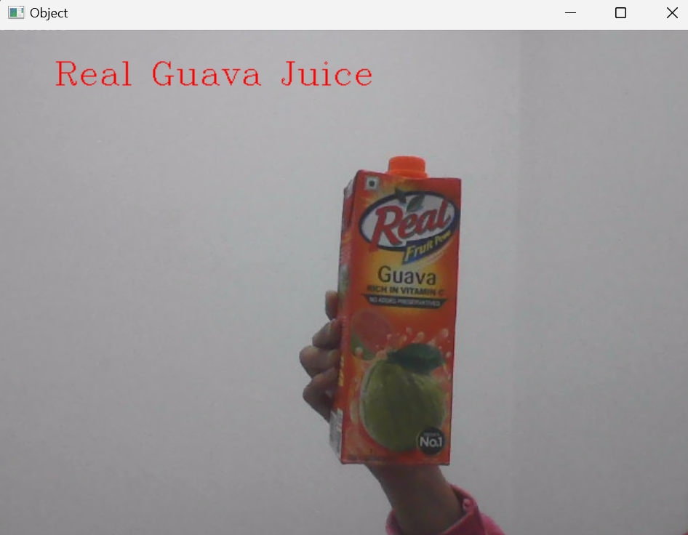
Some More Glimpses

Slide 10
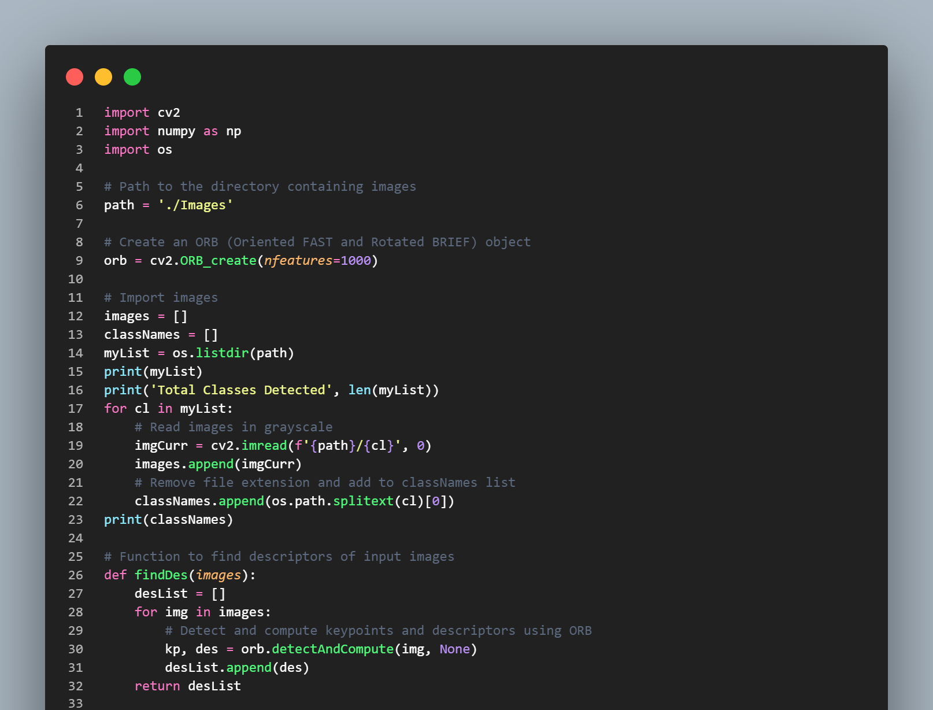
Code Snippets (Snippet 1)

Slide 11
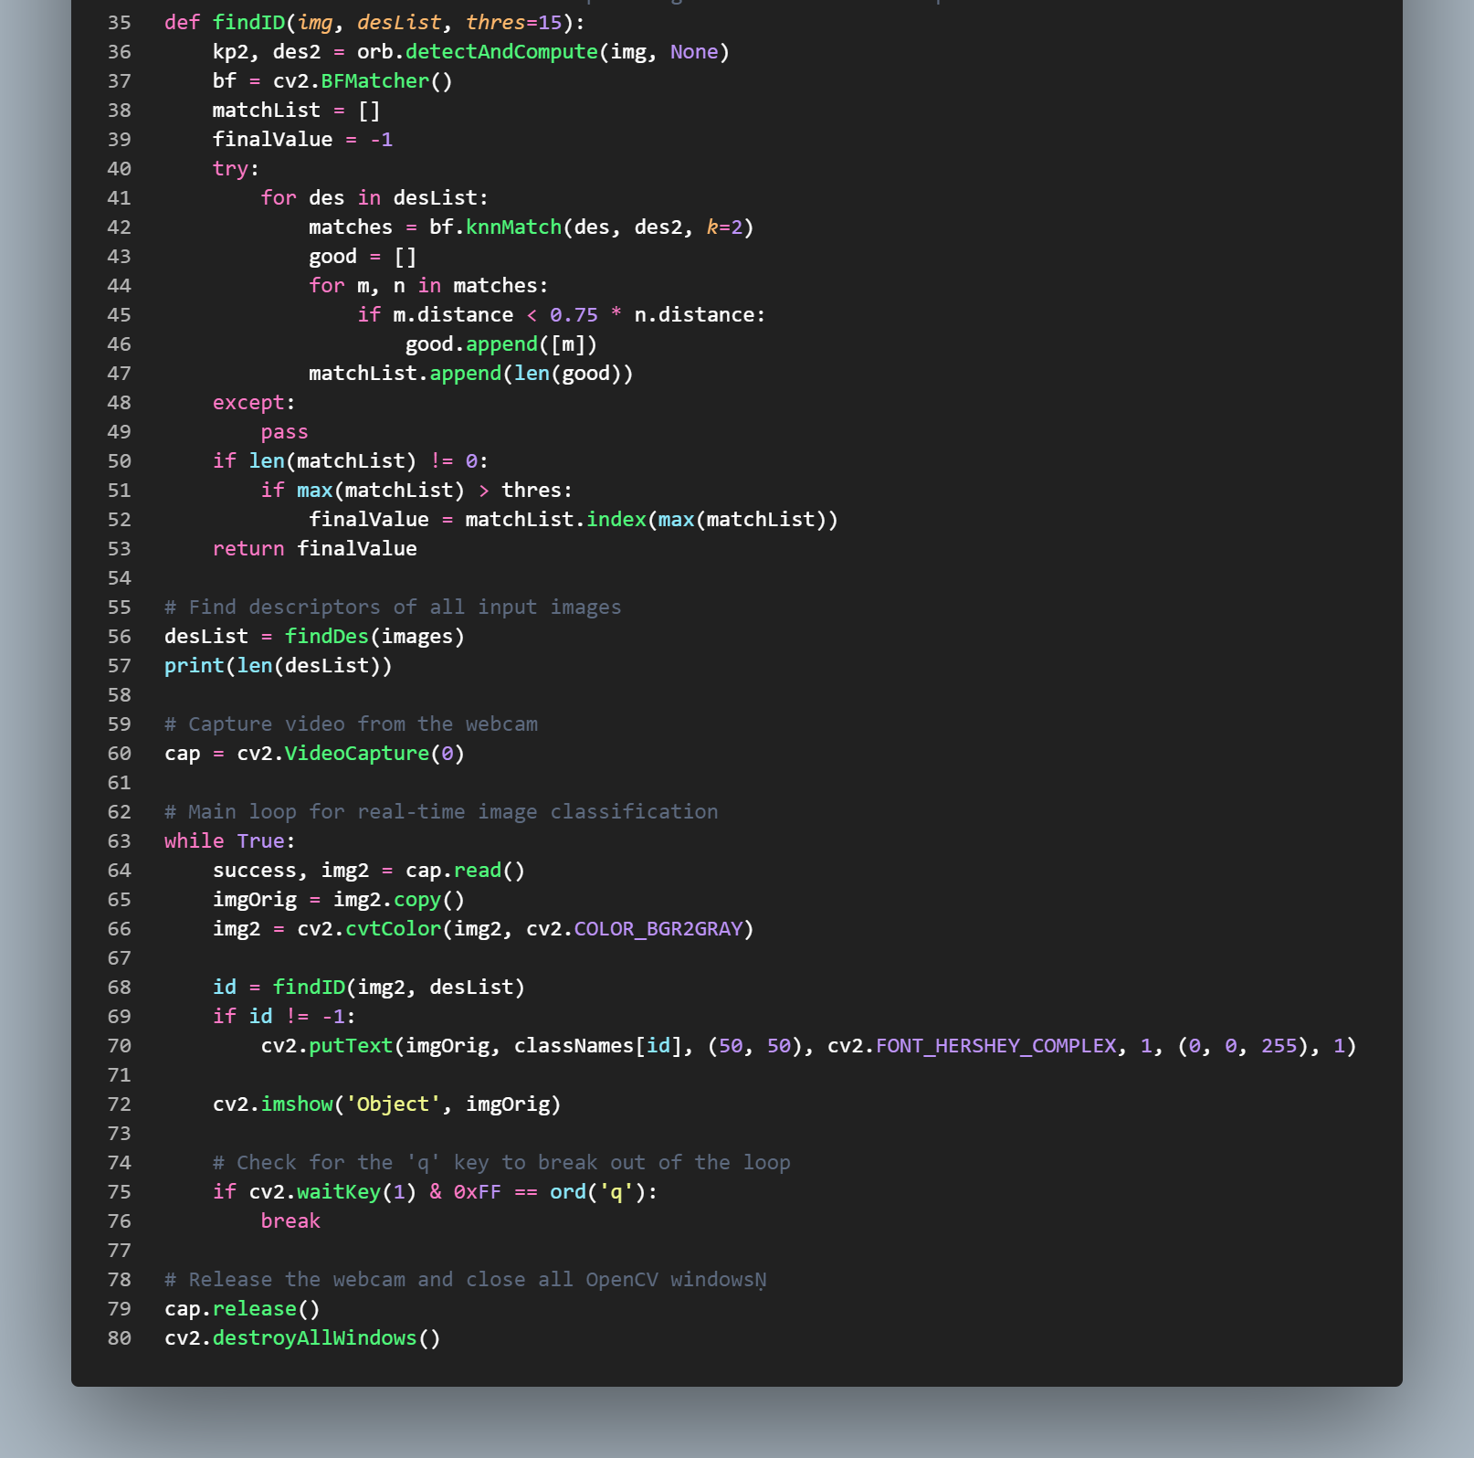
Code Snippets (Snippet 2)

Slide 12

Future Scope
Advanced Surveillance: Heightened security and awareness through surveillance advancements.
Industrial Maintenance: Predictive maintenance to boost efficiency across industries.
Augmented Reality Experiences: Anticipate more immersive AR environments through enhanced object recognition and spatial mapping.

Slide 13

References
OpenCV Official Website: OpenCV - Open Computer Vision Library
Geeks for Geeks: OpenCV Tutorial in Python – GeeksforGeeks
YouTube: https://www.youtube.com/

Slide 14


